Slide 1
Grant Writing 101
Hillsborough county council of pta’s & ptsa’s

Slide 2
Say YES to Grants!
Grants are a wonderful way to fund your PTA. Remember our purpose is to advocate NOT to fundraise.
National PTA grants are perfect for local units who have no experience with grants.
National PTA grants can help create meaningful programs that engage your students and community
National PTA offers grants EVERY YEAR – if you are not approved try, try, and try again.

Slide 3
National PTA Grant Writing Tips
Know What Grants Exist and When to Apply
Tell a Compelling Story
Share How the Grant Would Impact Your School Community
Show Your Enthusiasm
Answer All Parts of the Questions
Promote Family Engagement
Get a Second Set of Eyes

Slide 4
PTA Programs
The mission of every PTA is to ADVOCATE for our students NOT to fundraise. PTA Grants are a wonderful way to create new programs.
Check out some National PTA Programs: https://www.pta.org/home/programs
You DO NOT need a grant to do these programs at your school.

Slide 5
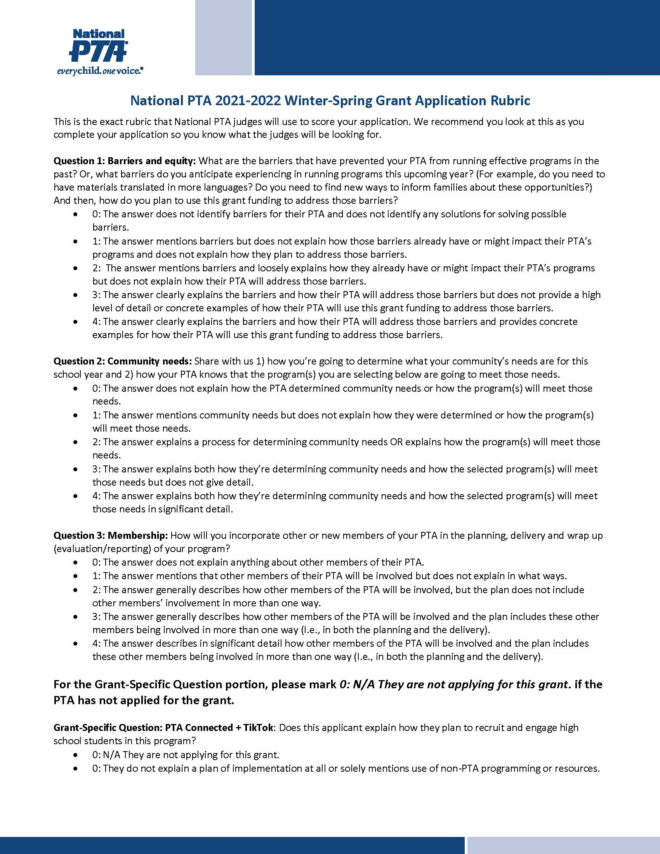

Slide 6
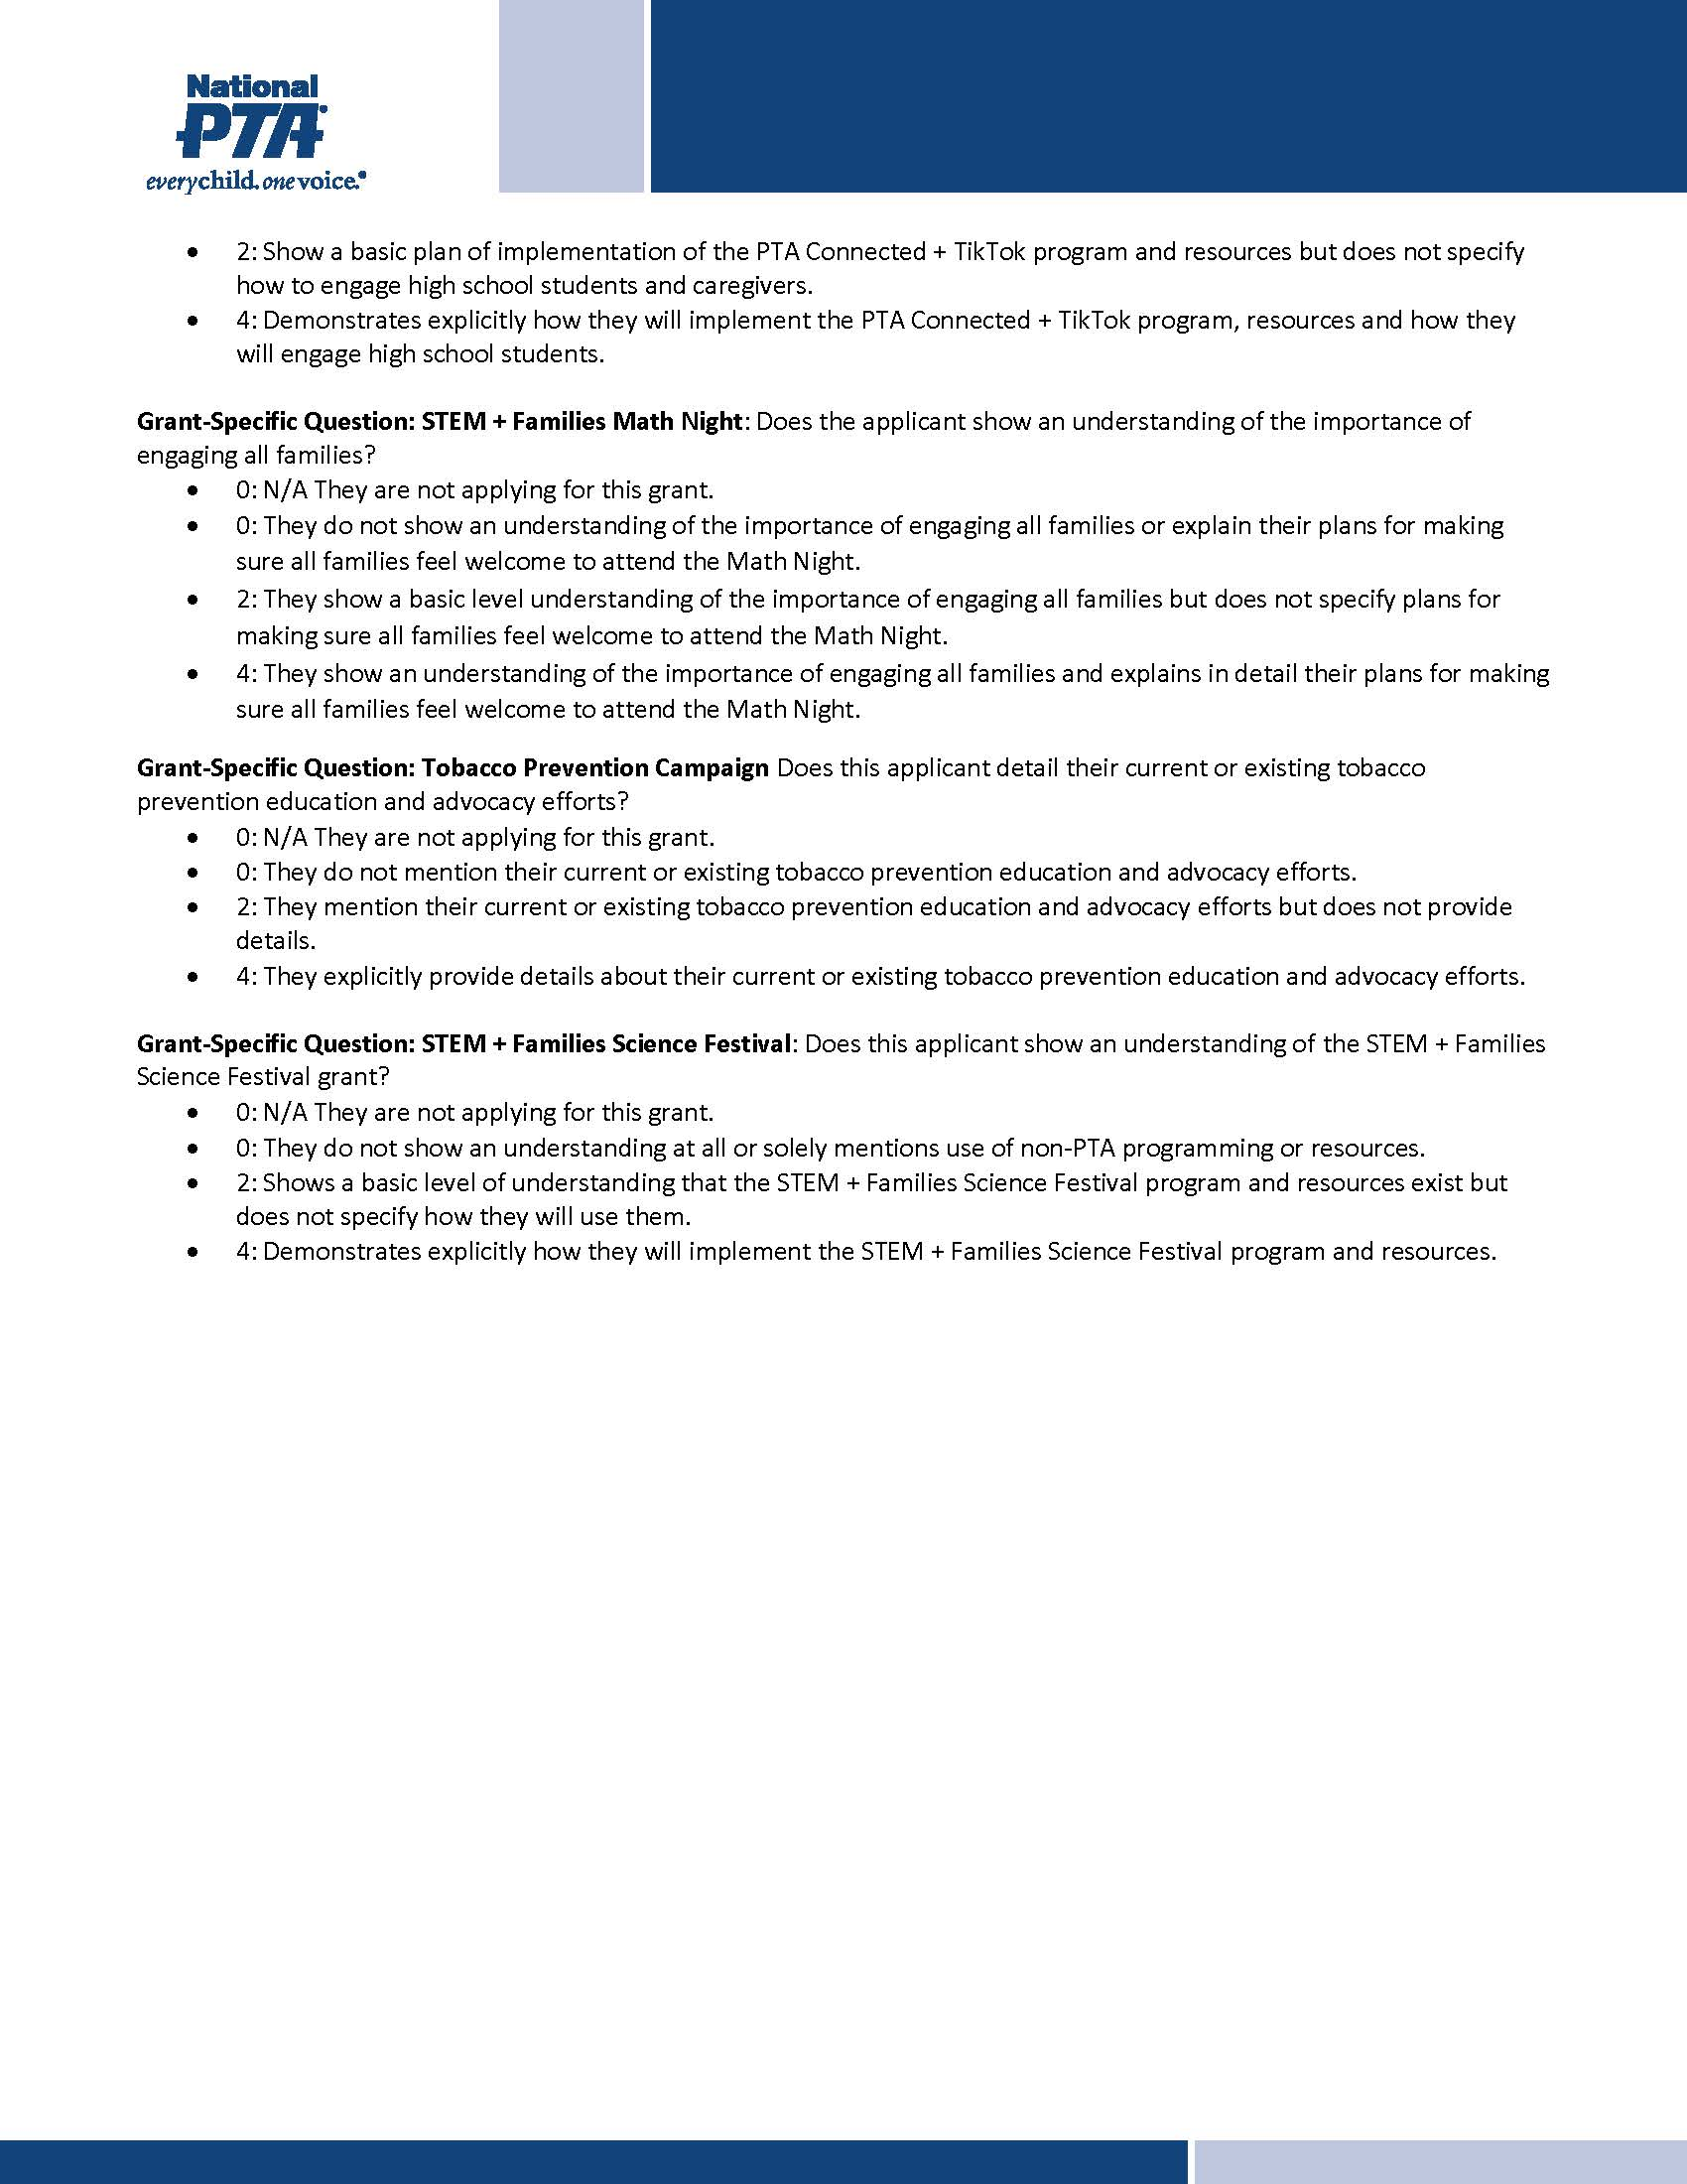

Slide 7
National PTA Grant Application Walk Through
https://www.loom.com/share/949910c8e37c4f9c8439827dfd54b2bd

