Slide 1
HILLSBOROUGH COUNTY COUNCIL PTA/PTSA AWARDS

Slide 2
Does your PTA…
Do lots of great programs?
Have special people who should be rewarded?
Make a positive change in your school and/or community?
YES! WE DID IT ALL!
Now’s the time to start applying for County Awards.

Slide 3
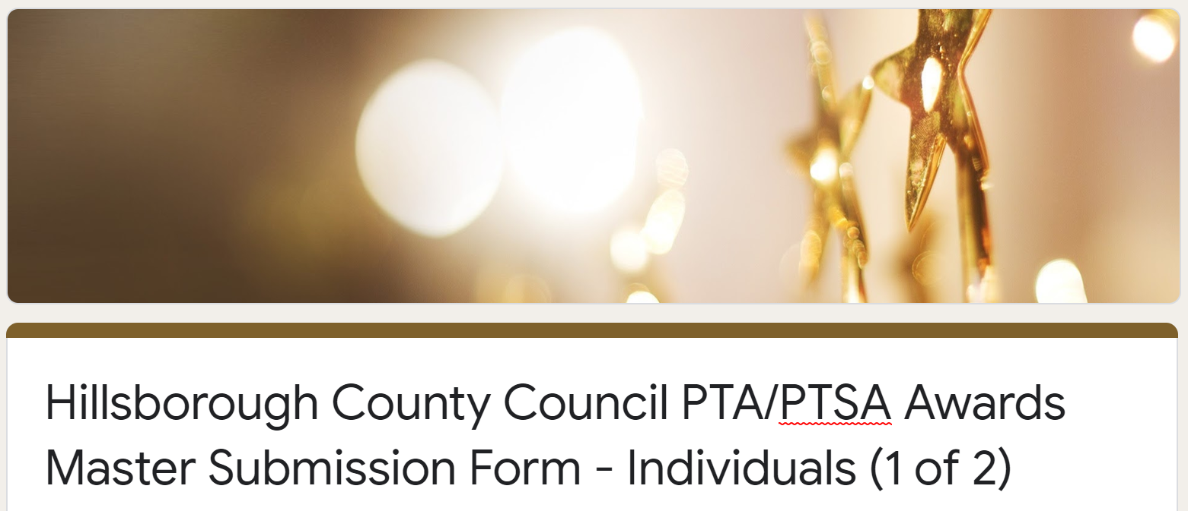
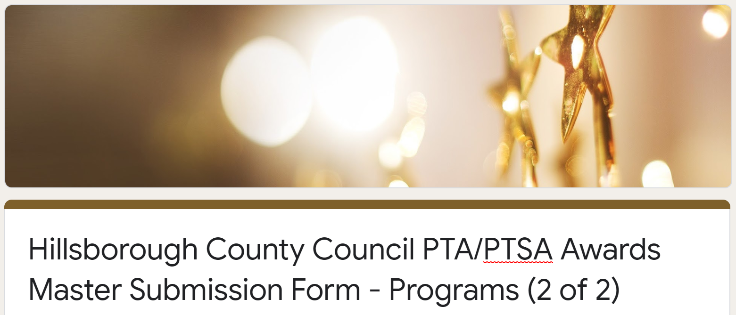
New This Year!
2 Separate Entries – Individuals & Programs Need to fill out both
Synopsis limited to 250 characters
Narratives limited to 3,000 characters
Attachments emailed to awards@hccptaptsa.org
Pictures supporting awards entries emailed to awards@hccptaptsa.org
Notes:
Explain that our website is being worked on.

Slide 4
Need to knows…
Eligibility – You must be in compliance with County Council and Florida PTA.
Your State and Council dues must be paid.
Your Bylaws must be current (Updated within the last three (3) years)
Your taxes must be filed.
Individual nominees must be a current member of your local unit
Purpose – Provided for each award, it explains what the award is about and what is needed in the narrative
Criteria – the submission must meet all of the criteria listed, or it may be disqualified
Narrative – Use this section to let your nominee shine! Tell us YOUR story!

Slide 5
What is needED for each submission?
3 Sentence Synopsis: This is the statement that will be read during the awards ceremony. You can include the nominated name and detailed description.
Narrative: Either copy and paste or type the awards entry. This will detail why nominated and how it supports the purpose of the PTA. DO NOT put any names, schools, mascots, or specific event names.
Attachment: Only needed for Communications. i.e. Newsletters or other communication means. Should be in PDF format and emailed to awards@hccptaptsa.org

Slide 6
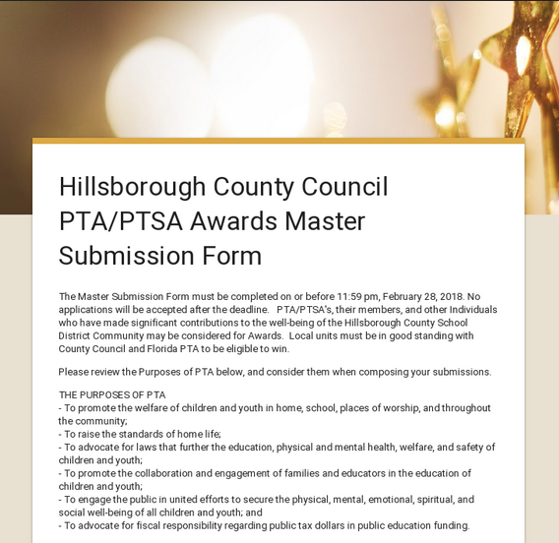
To apply…
Visit HCCPTAPTSA.ORG Locate the Awards page, and complete the entry for each of the links for Individual and Program Awards
Links will also be available on -
Hillsborough County Council PTA/PTSA FaceBook Page
Hillsborough County Council PTA/PTSA Awards Facebook Page
MemberHub
The applications will be available on our website beginning January 16.

Slide 7
Info YOU NEED TO Gather BEFORE YOU APPLY
Official name of PTA/PTSA
Date County dues was paid
Date State dues was paid
Date Bylaws were last approved
Date last year’s taxes were filed
Number of students at school
Number of PTSA Students (HS/MS)
Number of Volunteers and Volunteer Hours
Membership numbers for 2018 and 2019

Slide 8
Divisions
Elementary
Pre-K – 5th grade
Middle
6th – 8th grade
K-8 Schools
High
9th – 12th grade
All K-8 schools may apply for any award for which they are eligible.
K-8 schools will be judged in the middle school category.

Slide 9
Individual Awards
Instructional Person of the Year
Non-Instructional Person of the Year
Outstanding HS Senior or Student Led Program
Volunteer of the Year
Principal of the Year
President of the Year
Student of the Year
Superman
Start-up PTA
Notes:
Describe the different awards

Slide 10
Program Awards
Advocacy/Legislation
Arts In Education
Communications
Education
Family Involvement
Health & Safety
At Your Service/Three Star
Notes:
Describe the different awards

Slide 11
Certificate Awards
Golden Participation
Participated in 3 or more County/State Events
Volunteer Hours
Hours are at least 2 times the amount of members
Student Involvement
1 or more students on PTSA Board
Increased Membership*
*Numbers will be verified with Florida PTA
Notes:
Describe the different awards

Slide 12
Purposes of PTA
To Promote the welfare of children and youth in home, school, places of worship, and throughout the community;
To Raise the standards of home life;
To Advocate for laws that further the education, physical and mental health, welfare, and safety of children and youth;
To Promote the collaboration and engagement of families and educators in the education of children and youth;
To Engage the public in united efforts to secure the physical, mental, emotional, spiritual, and social well-being of all children and youth, and;
To Advocate for fiscal responsibility regarding public tax dollars in public education funding.
Notes:
Tell us how your nominee or program meets the PTA purposes. Make sure to include your WOW factors what made them to special, the impact, and how different your ideas were.

Slide 13
IMPORTANT
Entries are blind-judged - Do NOT mention your nominee, school, mascot or PTA/PTSA anywhere when writing your narrative as this will result in immediate disqualification
Focus your writing on the Purposes of PTA and how your nominee or program promoted these purposes.
You MUST include a three sentence synopsis of your application and the phonetic pronunciation of recipient’s name if applicable. Synopsis cannot be more than 250 characters.
Entries must be submitted no later than March 13th at 11:59 pm.
NO EXCEPTIONS!

Slide 14
Narrative
The narrative can be copied and pasted into the narrative section of the awards submission. It is slightly easier for the judges to see the narrative if it is copied and pasted directly into the form as you can edit for spelling and grammar before pasting.
Narratives cannot be more than 3000 characters. Judges read through many submissions so try to highlight exactly why this entry should be rewarded.

Slide 15
New This Year!
2 Separate Entries – Individuals & Programs Need to fill out both
Synopsis limited to 250 characters
Narratives limited to 3,000 characters
Attachments emailed to awards@hccptaptsa.org
Pictures supporting awards entries emailed to awards@hccptaptsa.org
Notes:
Explain that our website is being worked on.

Slide 16
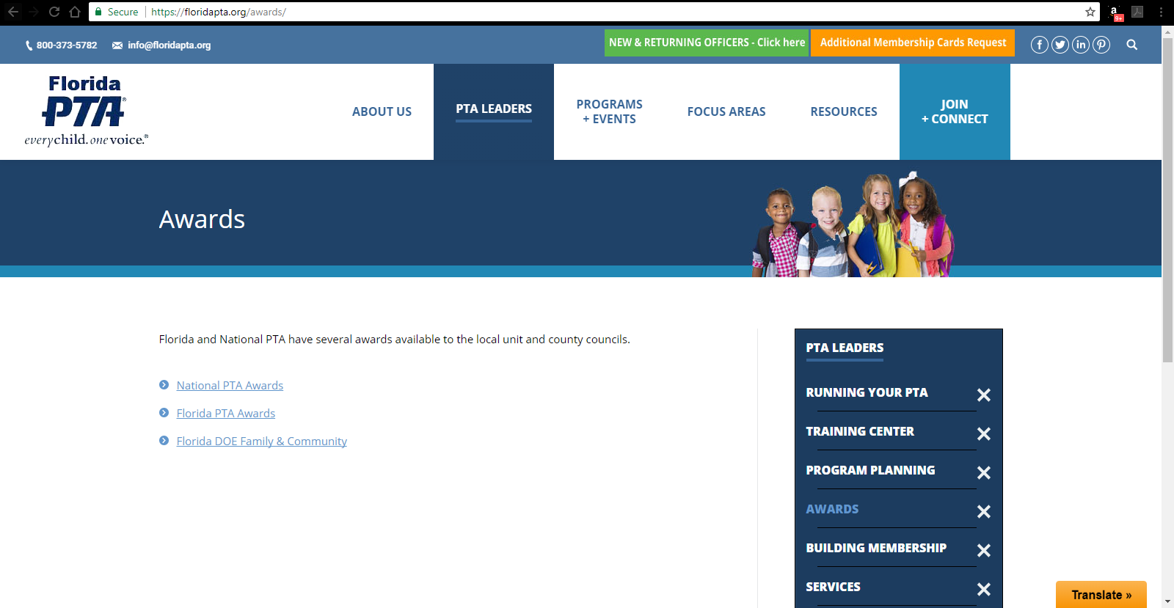
Don’t forget to check out www.floridapta.org to apply for state awards too!
** Deadline May 1st Hillsborough County won 8 awards last year!

Slide 17
Awards Gala
SAME LOCATION AS 2019!
April 16, 2020
Bryan Glazer Family JCC Event Center
Ticketing information will be available on the website soon!

Slide 18
Live Demo

Slide 19
Questions?
Ami Marie Grange Welch
VP of Council Operations
vpoperations@hccptaptsa.org
Janel Smith
Awards Chair
awards@hccptaptsa.org

