Slide 1
WELCOME!! Advancing Diversity, Equity and Inclusion in Your PTA
In the Chat…
Please share your name and PTA and why diversity, equity, and inclusion matters for your PTA.
This workshop is being recorded.
Notes:
Helen

Slide 2
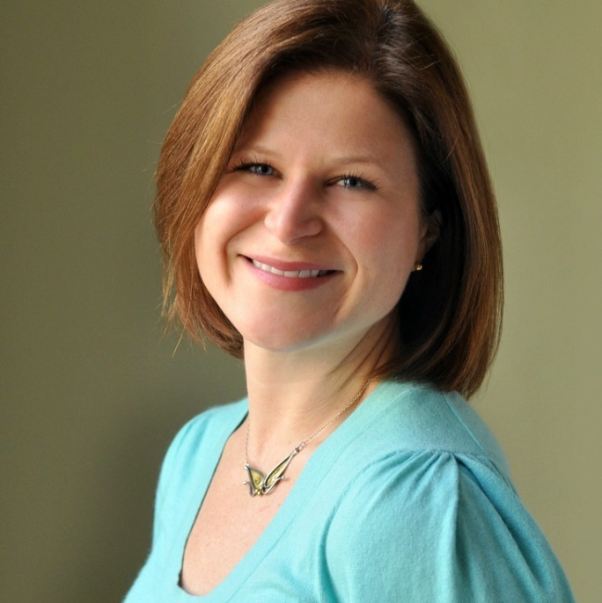
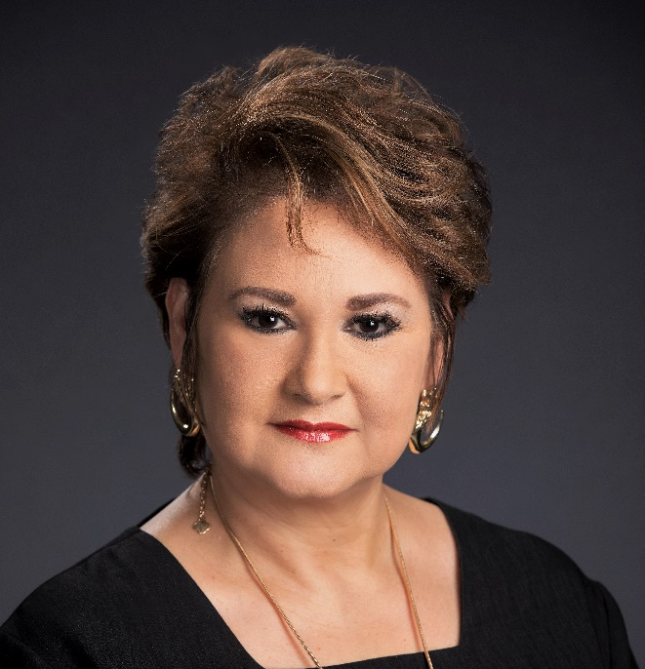
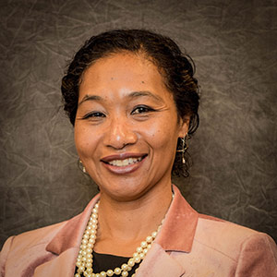
WORKSHOP SPEAKERS
Helen Westmoreland
Sylvia R. Reyna
Frances Frost
Notes:
All

Slide 3
BENEFITS OF ENGAGING ALL FAMILIES
Children whose parents are involved in school are more successful in school
Authentically advocate for the needs of all children
More voices * More hands!
Notes:
Helen

Slide 4
OUR OBJECTIVES:
Define concepts of diversity, inclusion, and equity; apply to your local PTA
1
Analyze the diversity, level of inclusion and equity in membership, governance, programs & advocacy in PTA
2
Discover strategies to increase diversity, inclusion and equity in PTA
3
Notes:
Helen

Slide 5
1
Define concepts of diversity, inclusion, and equity; apply to your local PTA
Notes:
Helen transitions to Sylvia

Slide 6
WHAT DO THESE TERMS MEAN?
Notes:
Sylvia

Slide 7
WE BELIEVE DIVERSITY IS OUR STRENGTH.
We represent parents, caregivers, educators and communities of all children, which enables us to best achieve PTA’s mission to make every child’s potential a reality. Our collective backgrounds, perspectives and ideas allow us to best reflect the rich fabric of 21st century children, families, educators and community members—and create the strongest future and direction for PTA.
In the chat:
What is one way diversity shows up in PTA?
Notes:
Sylvia

Slide 8
WE BELIEVE COLLABORATION MUST BE INCLUSIVE.
We can only achieve our mission and vision in full collaboration and partnership with the broadest possible set of volunteers, staff, educators, schools and communities. We foster an association where everyone feels they belong, are integral to achieving our vision and have the opportunity to flourish and contribute at the highest level. That means tending to power dynamics where they occur and setting up a level playing field for all to engage in our work.
In the chat:
What is one way inclusion shows up in PTA?
Notes:
Sylvia

Slide 9
WE BELIEVE EQUITY DRIVES OUR MISSION.
Equity provides fairness in resources, opportunities and outcomes so that all communities get what they need to be engaged and successful. This moves beyond an “equal across the board” approach to:
Recognize and address bias and privilege.
Understand and attend to specific individual and community needs, providing additional resources to those with greater needs.
In the chat:
What is one way equity shows up in PTA?
Notes:
Sylvia

Slide 10
Analyze where your PTA is on its diversity, equity, and inclusion journey
2
3
Define concepts of diversity, inclusion, and equity; apply to your local PTA
1
Notes:
Sylvia transitions to Helen

Slide 11
Diversity
At the Emerging stage, PTAs are focused on recruitment and building membership and leadership comprised of individuals from different backgrounds and experiences.
Inclusion
At the Intermediate stage, PTAs are focused on culture and creating an environment in which everyone is comfortable sharing and contributing their experiences.
Equity
At the Advanced stage, PTAs are focused on systems to improve equity. The primary goal is integration of an equity lens into all aspects of the association’s work.
The DEI Journey at PTA
Color/Identity-Blind
At the Beginning stage, PTAs are “color-blind,” or “identity-blind,” either by design or default and do not lift up issues of diversity, inclusion, and equity in any regular or routine way.
Notes:
Helen

Slide 12
Which stage reflects your PTA’s DEI efforts?
Beginning (Color/Identity-Blind)
B. Emerging (Diversity Focus)
C. Intermediate (Inclusion Focus)
D. Advanced (Equity Focus)
Audience
Reflection:
Notes:
Helen

Slide 13
KNOW YOUR SCHOOL AND PTA DATA
Have a clear understanding of your school’s demographic makeup
Highly Qualified Teachers
Absenteeism
Academic Achievement
Students Receiving Services
Suspensions & Expulsions
Graduation
What else?
Notes:
Helen

Slide 14
KNOW YOUR COMMUNITY
African-Americans
High schoolers
Non-Christians
Immigrants
Military
LGBTQ
Special education
Homeless
English language learners
Grand-parents
Essential workers
Magnet program
Notes:
Helen
Small group breakouts
This is your active part – Take out your paper or notes
Just from the top of your head – list the different groups or categories of the students and families in your school community. You might also include grade levels, or school programs – is there a magnet program, technical/vocational programs, alternative program in your school or district? You can decide if you want to do this at the school, district or state level, depending on your PTA role.
Put some of these groups in the chat – try to be additive to the list, it might be hard depending on how fast everyone types, but try to add something new. There is so much diversity in our country, that its impossible to run out of categories.
Now – on that same list or diagram – circle the ones who are adequately represented in your PTA. You have to consider your demographics, too. If your school is 40% Black students and there is one Black mom active in your PTA – don’t circle that. Think about who shows up for PTA meetings, who is vying for leadership positions, who is working on your committees. Compare that to your school demographics. All those people who you haven’t circled = that’s your target membership goal for next year. When we’re done, give a copy of this paper to your Membership chairman.
But for now, keep this list handy, we’re going to come back to this again.

Slide 15
Pause & Discuss
Which groups are under-represented in your PTA? What are barriers to their engagement?

Slide 16
IDENTIFY BARRIERS IN YOUR COMMUNITY
Culture
Expectations of parents’ role
Feeling welcome
Attitude towards school & institutions
Language
Socio-economics
Costs (real or assumed)
Availability
Other priorities
Institutional policies & practices
Time/location
Activities and format
Insider lingo
Relevancy of issues
Related to academic success of students
Relevant to parents’ priorities
Accessible advocacy activities
Notes:
Helen
Address what matters most to families and communities
Develop programs and activities in a way to overcome identified barriers
Be intentional about your efforts to increase diversity and be more inclusive

Slide 17
2
Discover strategies to move to more equity-centered membership, leadership, programs & advocacy
3
Define concepts of diversity, inclusion, and equity; apply to your local PTA
1
Notes:
Helen transitions to Frances

Slide 18
EQUITY IN PTA MEMBERSHIP
Notes:
Frances

Slide 19
EQUITABLE MEMBERSHIP
General Approach:
With a More EQUITABLE Lens:
Have little to no engagement with parents/community members who do not actively seek out organization
Assuming everyone knows what PTA is about
Not collecting or analyzing data by demographic group
Asking every parent to join the PTSA
Partnering with community organizations to reach out to potential members
Sharing messages that conveys that every parent belongs in PTA
Membership sponsorships
Notes:
Frances
Refer to the list of parents/families that are not represented in your PTA – that’s your target list. How are you going to reach them?
Asking every parent – including fathers/male figures - to join the PTSA
Partnering with community organizations to reach out to potential members
Messages that speak to every parent that they belong in PTA

Slide 20
CREATE EFFECTIVE PTA MESSAGING
Why PTA exists – what are the goals, what do you stand for
What your PTA has achieved
How parents’ engagement with PTA benefits themselves, their children and the school community
Address issues that matter most to the families and communities whom you seek to engage
What your PTA expects of members – dues, volunteering, advocacy, meetings
Notes:
Frances
What do families need to understand about the benefits of PTA?

Slide 21
Notes:
Frances

Slide 22
EQUITY IN PTA GOVERNANCE & LEADERSHIP
Notes:
Frances

Slide 23
EQUITABLE GOVERNANCE & LEADERSHIP
General Approach:
With a More EQUITABLE Lens:
Rotation of the same PTA leaders
Nomination Committee asks people they know to run for office
Plan a couple activities focused on diversity
Diversity committee helps every committee use a “DEI lens” in their workplans
Measure your progress on DEI efforts – both in headcounts and in impacts
Review bylaws for leadership requirements that may limit diversity in leadership
Notes:
Frances
We create leaders by encouraging active membership.
Realize – parents may have a lot of knowledge & skills to contribute, even if you’ve never seen them in a PTA meeting. You won’t know that the dad is an accountant, the mother does web-design, the grandmother is an ASL translator – until you ask.
Bylaws – Our bylaws may be too restrictive. For example: bylaws require that a parent has served as a committee chairman to run for an office – this may make sense in that you want people experienced in PTA as officers, but then who are you inviting to be committee chairman?

Slide 24
OVERCOMING STRUCTURAL BARRIERS
In the chat:
How would you refine or revolutionize PTA’s governance structures to advance diversity, equity, and inclusion?
Notes:
Frances

Slide 25
EQUITY IN PTA PROGRAMMING
Notes:
Frances

Slide 26
EQUITABLE PROGRAMS
GENERAL Approach:
With a More EQUITABLE Lens:
Program Committee hosts the same program(s) annually
Family Reading Night
Program Topic: Tips for Beach Week!
Family Reading Night with active parent participation, ELL supports, activities to take home, and feedback opportunities
Program Topics:
College Application Prep
Summer Employment Options
Keep programs relevant to families’ needs
Notes:
Frances
Invite new, diverse group of parents to program committee
Have feedback loops to seek input from underrepresented groups/ respond to community feedback
Programs keep pace of changing needs for parents, particularly those of underserved populations
Programs are accessible and relevant for families

Slide 27
EQUITY IN PTA ADVOCACY
Notes:
Frances

Slide 28
EQUITABLE ADVOCACY
General Approach:
With a More EQUITABLE Lens:
Everyone gets school supplies
Posting a #BlackLivesMatter image on social media
Advocating for history/social studies content that covers indigenous experiences
Discussing disproportionate discipline with school leaders
Advocating for more Black teachers in school
Coaching a parent on how to advocate for her child to receive their special education services
Notes:
Frances
General
Fear that lifting issues of difference and diversity will create conflict
Understand disparities in children’s educational success, health and well-being exist, but choose not to incorporate in advocacy plan
Do not have members from underrepresented population at the table to establish advocacy agenda
DOS
Act upon opportunity to speak on and advocate for issues impacting diverse and underrepresented communities
Engage with underrepresented parents and inquire about their priorities for their child
Prioritize these on advocacy agenda
General Issues: School issues that we think affect everybody equally
A More Inclusive Lense: How does this issue impact all of the students in our schools?

Slide 29
YOUR
COMMITMENT
In the chat:
What is one thing you will start, stop, or change to advance diversity, equity and inclusion in your PTA?
Notes:
Sylvia

Slide 30
Learn More!
PTA Leader Resource: How to Welcome Diverse Perspectives into Your PTA (en Español)
PTA Leader Training: PTA 101: The National Congress of Colored Parents and Teachers and Unification
Parent Resource: How to Talk to Your Child About Race and Injustice in America
Parent Resource: Notes from the Backpack: A PTA Podcast
National PTA’s Commitment to Diversity, Equity, and Inclusion (en Español)
National PTA’s Position Statement on Institutional Racism
Notes:
Helen

Slide 31
Resources from the
Diversity, Inclusion, & Outreach Committee
A community for resource-sharing, encouragement, and problem-solving!
National PTA Diversity, Inclusion, and Outreach Facebook Group
Questions for the Committee?
E-mail diversity@pta.org
Have something special to share about your DEI work or want to see some good examples?
Check out and apply for the Jan Harp Domene Diversity & Inclusion Awards
Notes:
Helen

Slide 32
Notes:
Helen

